Slide 1
Antidepressants
Prof. Dr. János Borvendég

Slide 2
Social significance of depression
The overal prevalence of depression in the developed world : 17,9%
40% of persones have concomitant mood disorder
Prevalence of suicidal ideation among adults with depression: 26,3%

Slide 3
Clinical symptoms of depression
anhedonia, fatigue
intense sadness, despair
pessimistic worry
lack of pleasure
self-deprecation
variable agitation/motoric retardation

Slide 4
Clinical symptoms of depression (cont.)
insomnia/hypersomnia
wight loss/overeating
decreased energy/libido
slowing and loss of concentration
recurrent ideas (suicidality)

Slide 5
Depression (?)
primary vs. secondary
endogenous vs. exogenous

Slide 6
categorisation of depression (dsm – IV)
Major depression (single episode/recurrent)
Bipolar depression
Dysthymia
Cyclothymia
Schizoaffective disorder
Postpartum depression
Organic depression
etc.

Slide 7
Bipolar depression
is frequently misdiagnosed as major depression, and is thus treated with antidepressants alone which is not only not efficacious it is often contraindicated as it may exacerbate hypomania, mania, or cycling between depressed moods with some hypomanic symptoms

Slide 8
biological theories on pathology of depression
NA (noradrenaline)
5-HT (serotonine)
Ch (cholinergic activity) decreased
neurotransmitter dysregulation
(5-HT / NA / DA / dopamine), GABA

Slide 9
a) na hypothesis
The urine excretion of MHPC (metabolic of NA) decreases in depression.
rauwolfia treatment -> depression
clonidine (α2 agonist) -> depression
tricyclic antidepressant -> antidepressive effect
hydrazin type anti TB drugs -> antidepressant effect

Slide 10
Noradrenalin
may be related to alertness and energy as well as anxiety, attention, and interest in life;

Slide 11
b) Serotonine hypothesis
The conc. of 5-HIAA (5-hydroxy-indol-acetic-acid) decreases in depression
Triptofan -> antidepressive effect

Slide 12
Serotonin
is hypothesized to regulate other neurotransmitter systems; decreased serotonin activity may allow these systems to act in unusual and erratic ways. ] According to this "permissive hypothesis", depression arises when low serotonin levels promote low levels of norepinephrine

Slide 13
dopamine
another monoamin neurotransmitter to attention, motivation, pleasure, and reward, as well as interest in life

Slide 14
c) Cholinergic hypothesis
physostigmine -> depression
cholinergic activity -> antidepressive effect

Slide 15
d) Dysregulation hypothesis
Dysregulation of serotonine/noradrenerg transmission
Dysregulation in NA/cholinerg balance
Dysregulation in dopaminerg/GABA system
E.g. The activity of neurotransmission in case of psychic stress is inadequate:
decreased or great variability in its the response,
it takes longer time to achive state of rest
the normal circadian rythm is impaired

Slide 16
Other Factors whics may contribute to the development a depression
The monoamine hypothesis, already limited, has been further oversimplified usually phrased as a „chemical imbalance.
Gen-enviroment interaction (GxE) is hypothetised : why life stress is a predictor for depressive episodes in some individuals, but not in others, depending on an allelic variation of the serotonin-transporter-linked promoter region

Slide 17
Social isolation are associated with increased risk of mental health problems in general
Child abuse or neglect is also associated with increased risk of developing depressive disorders later in life.
The lack of social support may increase the likelihood that life stress will lead to depression,
This can occur when people hold negative self-stereotypes about themselves.

Slide 18
the main biological effects of various antidepressants
Inhibit the reuptake of
noradrenaline (NA)
serotonine (5-HT) from the synaptic cleft
Stimulate their postnaptic receptors

Slide 19
receptor binding assay of psychoactive agents
α/β adrenerg receptors
D1 D2 (!) D3 D4 dopamin receptors serotonin receptors
5-HT 1A -> anxiolytic
5-HT 2A
5-HT 2C -> antipsychotic
5-HT 6 (striatum)
5-HT 7 (hypothalamus, limbic area)
Benzodiazepine recptors
Muscarine (M1, M2, M3) receptors
H1/H2 receptors
NMDA receptors

Slide 20
Animal model of Depression
( many symptoms are hard to be produced in laboratory animals)
behavior despair : -tail suspension test (mice), --forced swimming test (mice) Parameters: the duration of time of escape like behavior and time to development of an immobile behavior
Dark/light box test ( mice) Drug induced increase in time of staying of the animals in the illuminated part of the two compartments are considered as an index of anxiolytic activity of the product.
Maternal deprivation stress model) Pups are separated from he dam for 1-24 h per day during the first two postnatal weeks.

Slide 21
Tretament of Major Depression
Main goals: ---treatment of acute symptoms ( 6 weeks) maintenance of the effect (6 months) prevention of new episode ( 24 months)
Study design: randomized, double blind comparisons versus placebo (superiority ) or active comparator
Efficacy criteria: Hamilton Rating Scale of depression( 17 items) Montgomery Asberg Depression Rating scale Clinical Global Assessment scale

Slide 22
antidepressants
„older”: tricyclic (TCA)
heterocyclic (HCA)
monoamino oxidaze inhibitors (MAO)
„newer”: selective serotonine reuptake inhibitors (SSRI)
serotonine+noradrenaline reuptake inhibitors (SNRI)
noradrenalin and specific serotoninerg antidepressants (NaSSA)

Slide 23
ANTIDEPRESSANTS | Compound | Trade name | Daily dose
Tricyclic | imipramine klomipramin amitriptilin dibenzapin trimipramin | Melipramin Anafranil Teperin Noveril Sapilent | 100-300 100-150 100-300 160-480 100-300
Tetracyclic | maprotilin mianserin | Ludiomil Tolvon | 75-150 20-90
Atypical (serotonine reuptake inhibitor) | trazadon nefazodon | Trazodon Serzone | 5-30 (max 80) 50-600
Selective (serotonine reuptake inhibitor) | fluvoxamine fluoxetine citalopram peroxetin sertraline | Fevarin Prosac Seropram Seroxat Zoloft | 100-400 20-40 20-40 20-40 50-100
Atypical (serotonine+NA reuptake inhibitor) | milnacipran venlafaxine duloxetine | Efexor/Faxin | 75-375
NaSSAs | mirtazapine agomelatine
MAO inhibitors | moclobemide L-deprenyl | Aurorix Jumex | 300-600 20-30

Slide 24
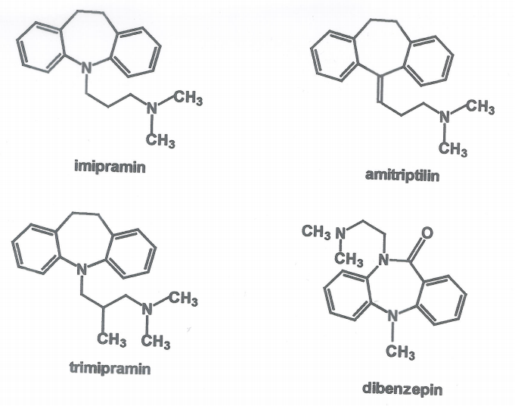
tricyclic antidepressants

Slide 25
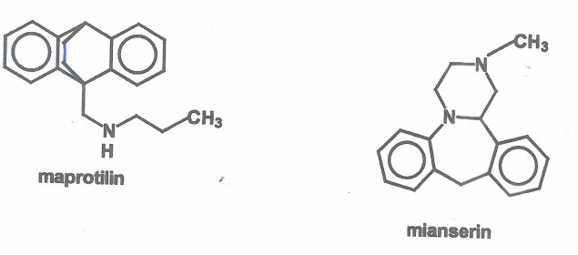
tetracyclic antidepressants

Slide 26
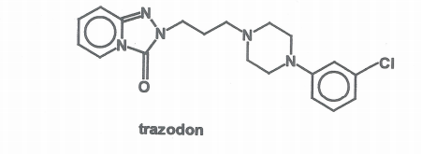
Non-selective serotonine reuptake inhibitors

Slide 27
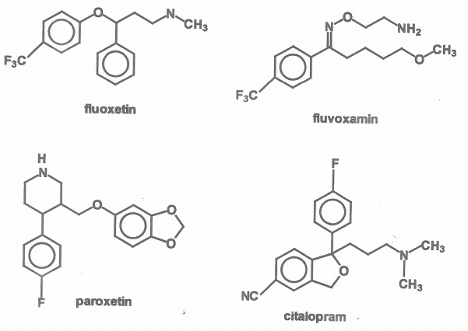
ssri (selective serotonine reuptake inhibitors)

Slide 28
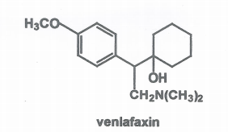
SE + NA reuptake inhibitors

Slide 29
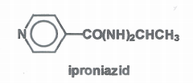
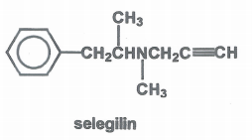
MAO (monoamin oxidaze) inhibitors
hidrazid
propargilamin
reversible MAO-A inhibitor

Slide 30
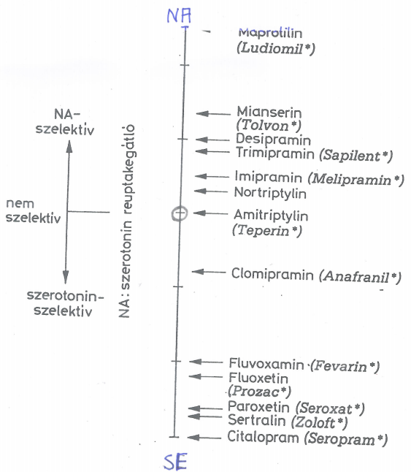
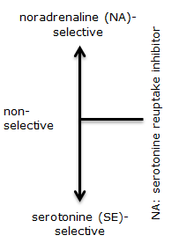

Slide 31
relatively new antidepressants
vilazodone (Viibryd R) (Merck) unique antidepr. (no weight gain, no sexual dysf.)
SE reuptake inhibitor but also 5-HT1A partial agonist
duloxetine (Cymbalta R) Eli Lilly SNRI reuptake inhibitor
ind.: depression/neuropathic pain
„top-selling/most popular antidepressant”

Slide 32
brand-new antidepressants
levomilnacipram (Fetzima) /SNRI/ Pierre Fabre Group
improved version of milnacipram
(levo stereoisomer)
reuptake inhibitor: NA > SE
New informations:
vomilnacipran is an NMDA ( N- methyl D- Aspatrat)receptor antagonist at high concentrations.]
Levomilnacipran has recently been found to act as an inhibitor of beta amyloid precursor protein enzyme of1 (BACE-1), which is responsible for B amyloid plaque formation, and hence may be a potentially useful drug in the treatment of¹Alzheimer disease.^{[3]}

Slide 33
brand-new antidepressants
vortioxetine (Brintellix R) Lundbeck/Takeda
SMS (serotonine modulation and stimulation)
ind.: major depression
various anxiety disorders (?)
side-effects: nausea, sexual dysfunction, dizziness

Slide 34
newest antidepressants in developement
SNDRI (triple reuptake inhibitors) SE/NA/DA
It is plausible that triple reuptake inhibitors that minimize blockade at histaminergic, cholinergic, and alpha-adrenergic receptors may yield the most favorable tolerability of all antidepressants with less sexual side effects.
But the the novel triple reuptake inhibitors have not been systematically studied regarding its clinical or preclinical antidepressant effects.
Ketamine (?!) „illict” substance.
Not only allaviate depression, but when given i.v. ketamin does it very quickly.

Slide 35
Ketamine
What is ketamine?
Ketamine is an anesthetic drug that blocks pain. It was first developed in the 1960
Anesthetic ketamine could offer hope for people who don't have other depression treatment options.
The drug works quickly, makes dramatic improvements in mood, and can work on people who haven’t gotten better with other depression treatments.

Slide 36
Ketamine
Ketamine blocks a type of receptor in the brain, known as NMDA ( N-Methyl-D Aspartat), thought to play a role in depression. Recent studies find that ketamine can have long-lasting effects on depression, even though the drug only stays in the body a short time.

Slide 37
Ketamine
But ketamine makes users feel like they're detached from their own body. This out-of-body sensation has made it a popular club or party drug, and it goes by nicknames like "Special K”
Doctors are worrying because don't know much about the long-term effects of ketamine because they haven't studied it over long periods of time. Studies have linked regular ketamine use to memory issues and other problems related to thinking, but this doesn't seem to be the case with the doses used to treat depression. Doctors also worry that the drug might lead to abuse, and to illicit use.

Slide 38
parameter of choice
therapeutic efficacy
adverse effects
drug/drug interactions

Slide 39
therapeutic efficacy
Efficacy of treatment depends on:
severity
polarity (=the mood of the patient is relatively stabil or „up and down”)
duration of depression

Slide 40
combined treatment
bipolar depression
SSRI + valproate,
carbamazepine,
lithium
antipsychotics (!)
chronic depression/dysthymia
SSRI = MAO
rapid cycling -> mood stabilizer

Slide 41
Selecting antidepressant therapy based on cluster symptoms
Depression with:
anxiety: citalopram, sertralin
fatigue: norepinephrine, dopamin reuptakeinhibitors:venlafaxine,fluoxetine
insomnia: mirtazapine, nefazodone, agomelatin
pain: duloxetin,TCA
cognitive problems: vortioxetine

Slide 42
Adverse effect of antidepressants
anticholinerg: dry mouth
constipation
visual disturbances
urine retention
tachycardia
α-rec. block.: orthostatic hypotension
H1 rec. block.: sleepiness
sedation
others: allergy
nausea
headache
haematological tox.

Slide 43
most commonly prescribed antidepressants in the USA
sertraline Zoloft SSRI
citalopram Celexa SSRI
fluoxetine Prosac SSRI
escitalopram Lexapro SSRI
trazodone Desyrel SARI
duloxetine Cymbalta SNRI
paroxetine Paxil SSRI
amitriptyline Elavil TCA
venlafaxine XR Effexor XR SNRI
bupropion XL Wellbutrin NDRI
mirtazapine Remeron TCA

Slide 44
how to use properly the antidepressants ?
The selected product should be given in „personalized” dose.
The antidepressant effect if the product will appear only after 3-4 weeks of the treatment.
In case of resistency checking the actual plasma level of the active substance strongly recommended.
Augmentation of depression drugs is only a relatively new idea (with aripiprazole, quetiapine)
(„Wait and see!”)

Slide 45
New Antideprassant Therapy?
Antidepressants are ripe for a change. Their history has been one of significant advancement; since the first discovery of tricyclic antidepressants in the 1950s
A new age of antidepressant therapies may well be coming, though, not just in new ingredients, but in how we approach mood imbalances in the brain.

Slide 46
thank you for your attention !

Slide 47
Diagnosis assesment
A diagnostic assessment may be conducted, or by trained general practitioners, psychiatrics who records the person's current circumstances, biographical history, current symptoms, and family history. The broad clinical aim is to formulate the relevant biological, psychological, and social factors that may be impacting on the individual's mood.

Slide 48
Items of Hamilton Rating scale
depressed mood feeling of guilt suicide idea insomnia work and activity, psychomotor retardation agitation anxiety somatic symptoms genital symptoms loss of weight paranoid symptoms depersonalization obsessional and compulsive symptoms

Slide 49
therapeutic efficacy
TCA vs. SSRI ≈ equally effective
TCA vs. MAO ≈ equally effective
MAO vs. SSRI ≈ equally effective
TCA vs. SSRI ≈ equally effective

Slide 50
Tretament of Major Depression
( cont.)
The proponents of this theory recommend the choice of an antidepressant with mechanism of action that impacts the most prominent symptoms. Anxious and irritable patients should be treated with SSRIs or norepinephrin reuptake inhibitors and those experiencing a loss of energy and enjoyment of life with norepinephrine- and dopamine-enhancing drugs.^{[45]}

